Slide 1
Journey Mars Rover Simulator
Cameron Jones

Slide 2
Problem Statement
Understanding the inner workings of real time systems can be confusing
There are no toy real time systems that allow for users to play and experiment with these concepts.

Slide 3
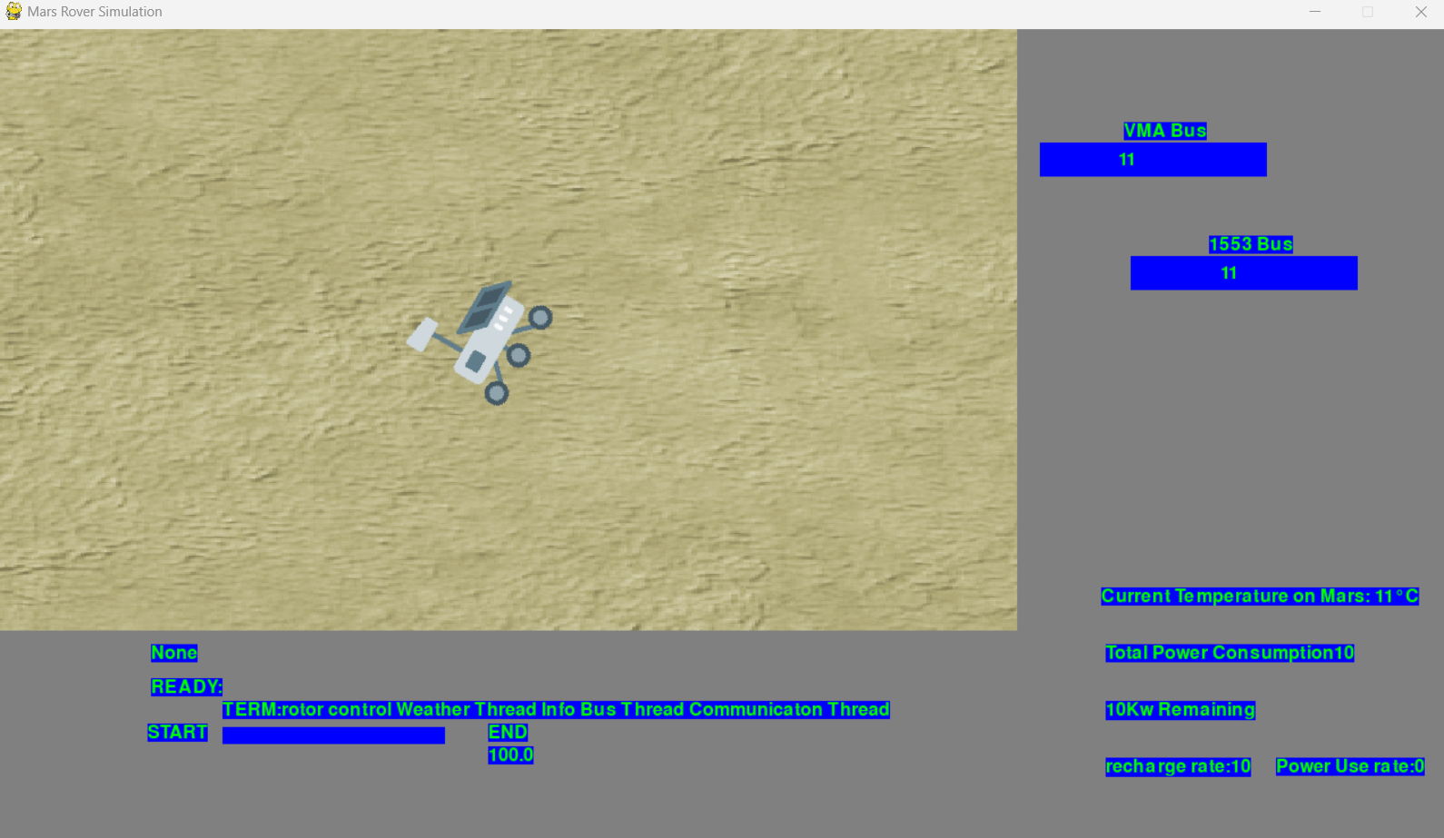
Solution
Create a simulation that visualises a real time system working in real time
Allow for customization of scheduling algorithm, access control protocol, periodicity and computation time of tasks

Slide 4
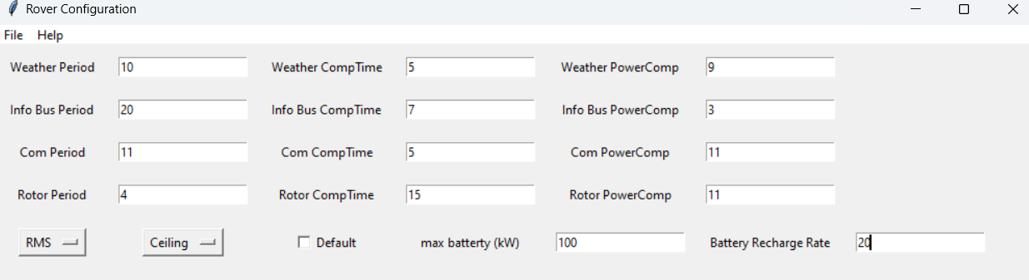
Solution
Allows users to experiment with different set ups
Letting them see intuitively the positives and negatives of each algorithm/protocol

Slide 5

Implementation
Language
Python
Graphics:
PyGame
Program continually loops performing scheduling checks each pass
RMS/EDF: Ready queue managed by priority queue
Use system time to track when tasks start and when tasks should stop

Slide 6
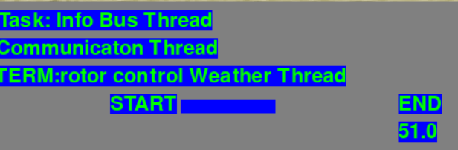
Implementation
Each iteration of main loop iterate through terminated list return task to ready queue
RMS: Upon running method RMSPriorityGen() assigning each task a priority value
EDF: EDFPriorityGEN each loop mangages Ready queue

Slide 7
Implementation
Traditional semaphore: run Cantrun() method before task begins to check if required critical section is not taken by another task
Priority Ceiling: When Cantrun() fails performs PCP, each task has variable originalPriority when finished priority is set to this value.
Priority Inheritance: CantRun() checks current critical section access protocol if Priority Inheritance selected check the held status of each register and the priority of the task holding the register

Slide 8
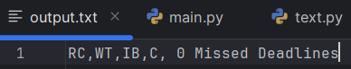
Testing/Evaluation-Scheduling Algorithms
Started with no preemption/critical region conflicts
Later introduced schedules with critical region conflict/preemption
Performance metric: Queues filled properly, tasks end when system time - starttime > task.compTime
Displays the previous run schedule: RC = Rotor control, WT=Weather, IB=InfoBus,C=Communication

Slide 9
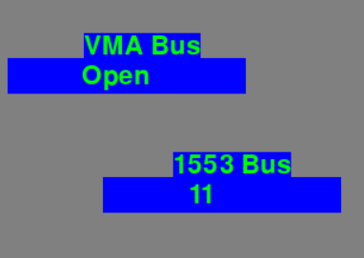
Testing/Evaluation-Critical section access protocols
Test: Simulate schedule that guarantees a task trying to access an already held critical region.
Performance metric: Task returns to ready queue/priority inherited

Slide 10
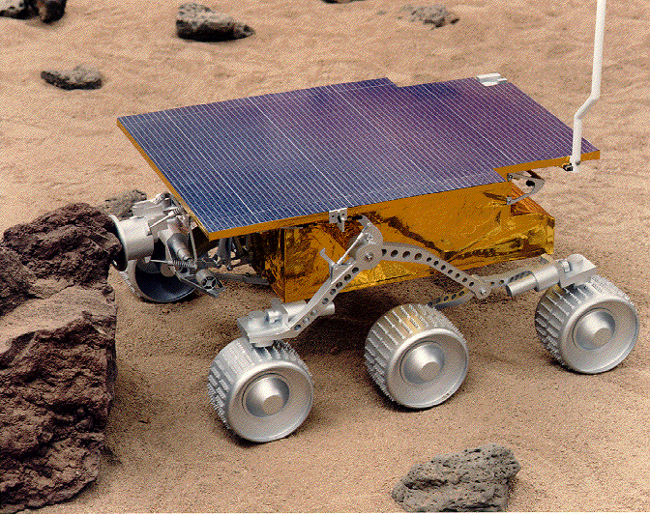
Conclusion
RMS, EDF, Round robin successfully implemented
Priority Inheritance implemented, priority ceiling implementation pending
Successfully added power functionality
Additional testing likely needed not all edge cases tested

Slide 11
Learning Achieved
Avoid god classed
Plan out project structure before anything else
Making relevant testing variables visible at all time greatly helps testing
Reviewed concepts behind all algorithms/protocols covered in simulation

